Slide 1

Team 1
Aastha Arora A0178188l
Pradeep Kumar A0163453H
Rubi Saini A0178255W
Boo Kia Twuan Kevin A0122213A
Peeravich Jirathiyut A0178491R

Slide 2
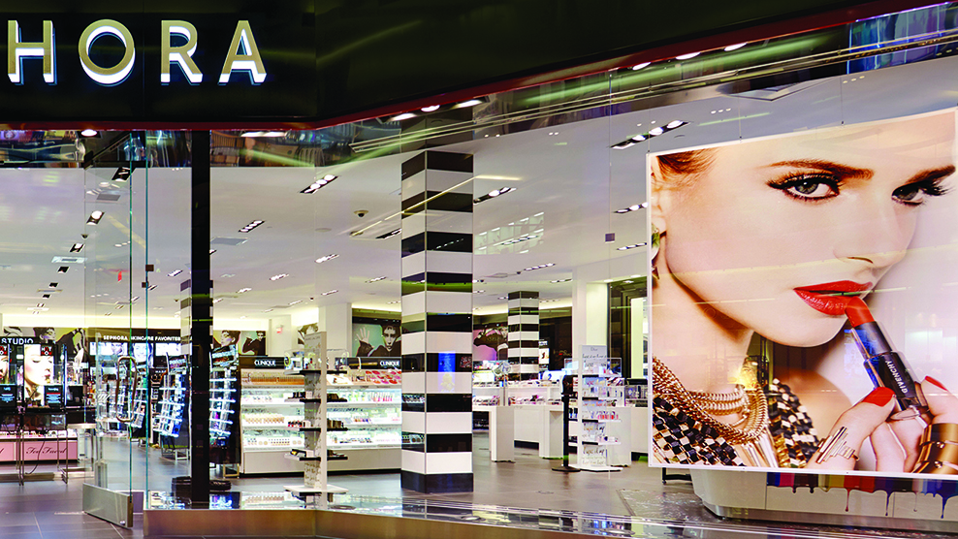
AGENDA
Introduction
Business Requirements
As-Is Process
Challenges & Pain Points
Proposed Tech Innovation
Conclusion
Notes:
Introduction
Business Requirements
As-Is Process
Challenges & Pain Points
Proposed Tech Innovation
Conclusion

Slide 3
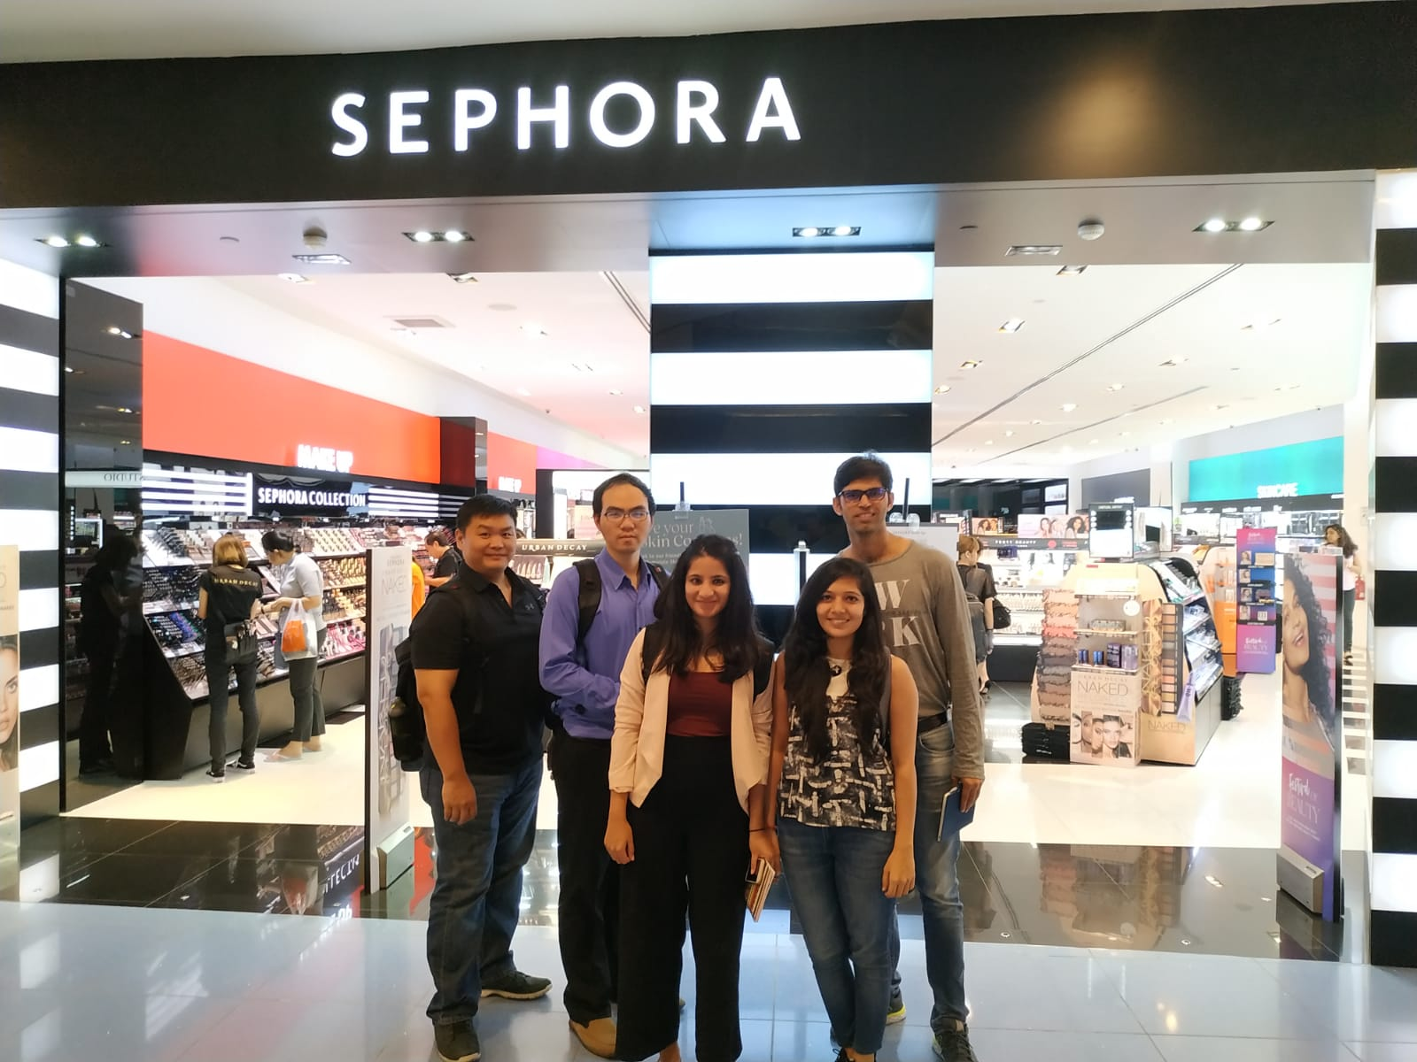
INTRODUCTION
A visionary beauty retailer
Nearly 300 brands beauty products
Provides unique shopping experience
Try, Play Dare and Enjoy

Slide 4
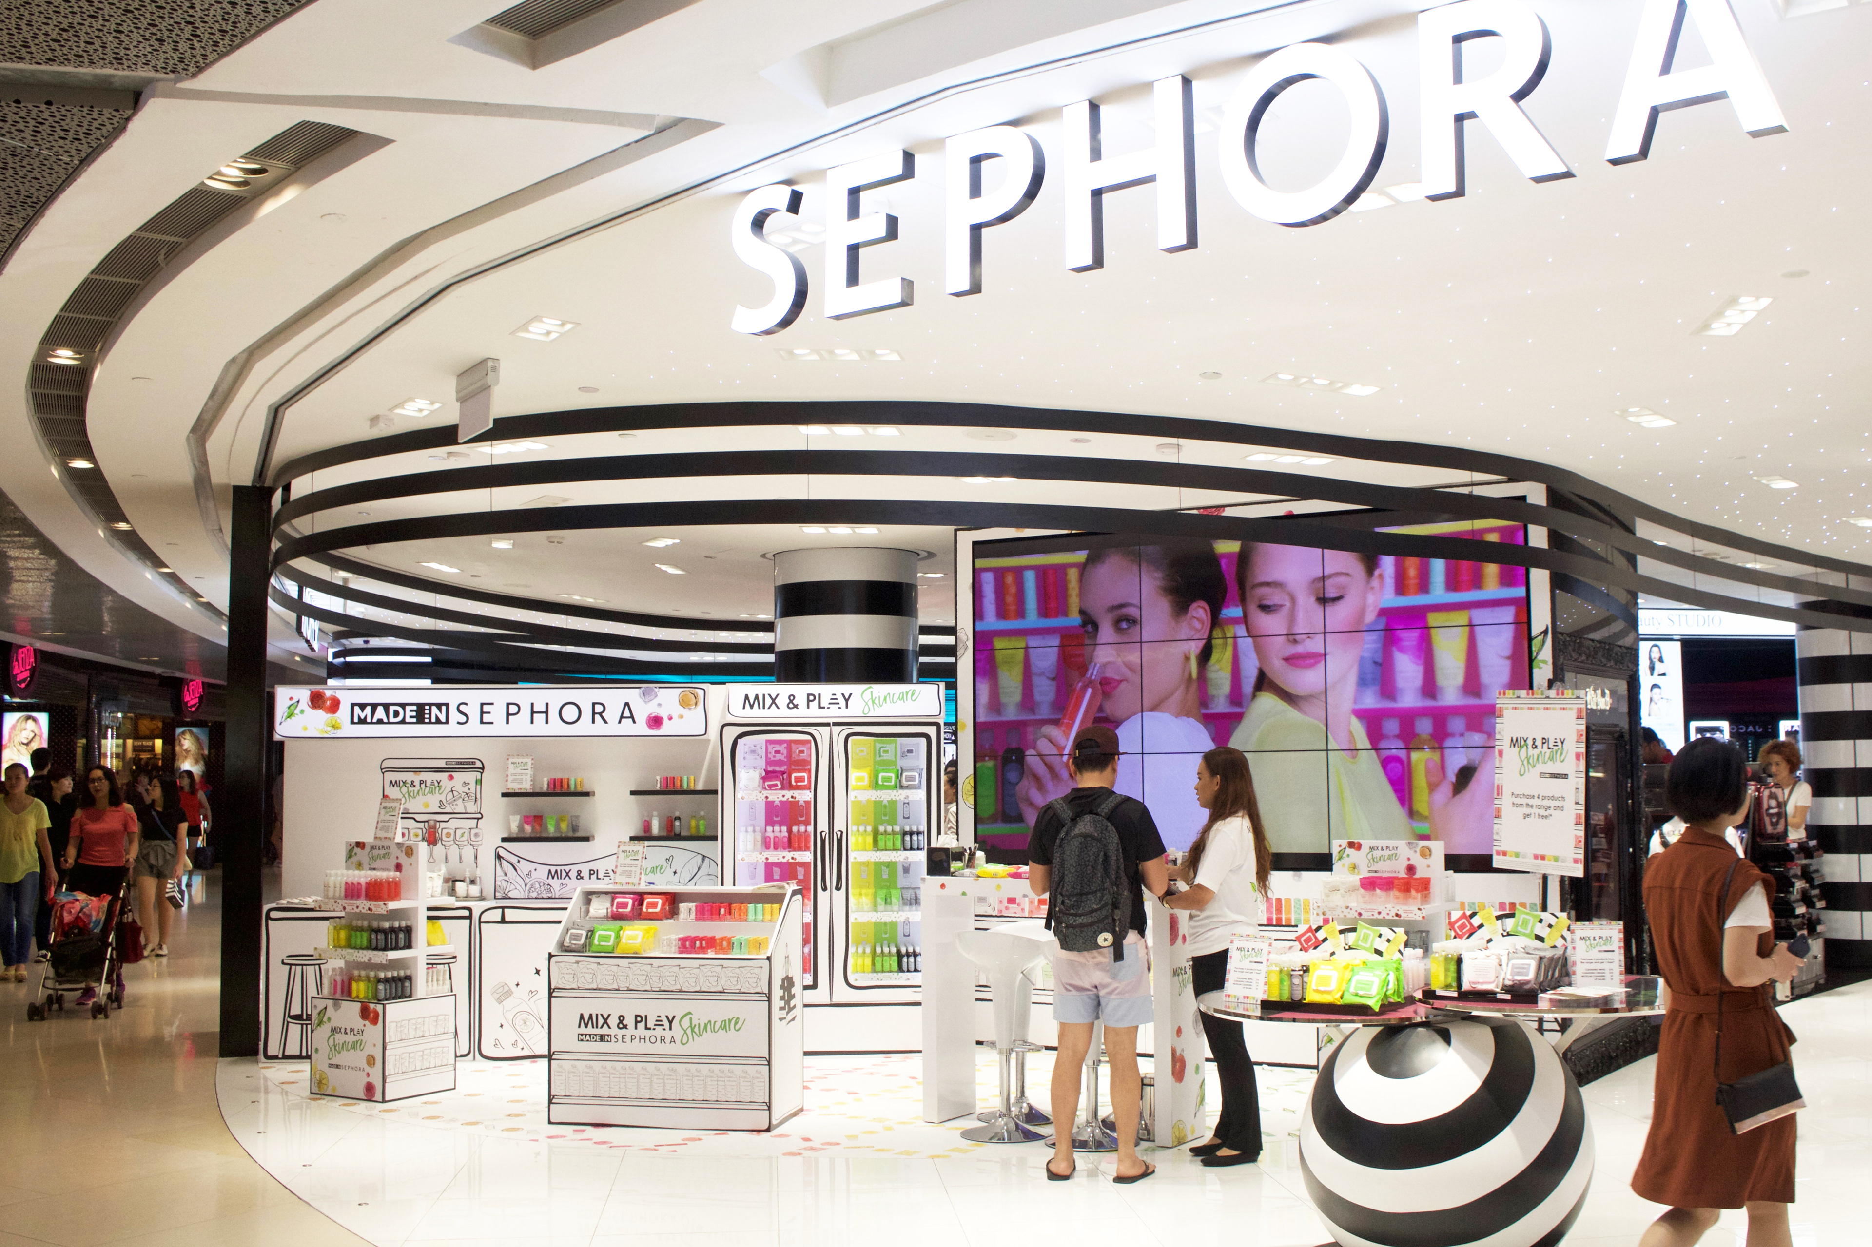
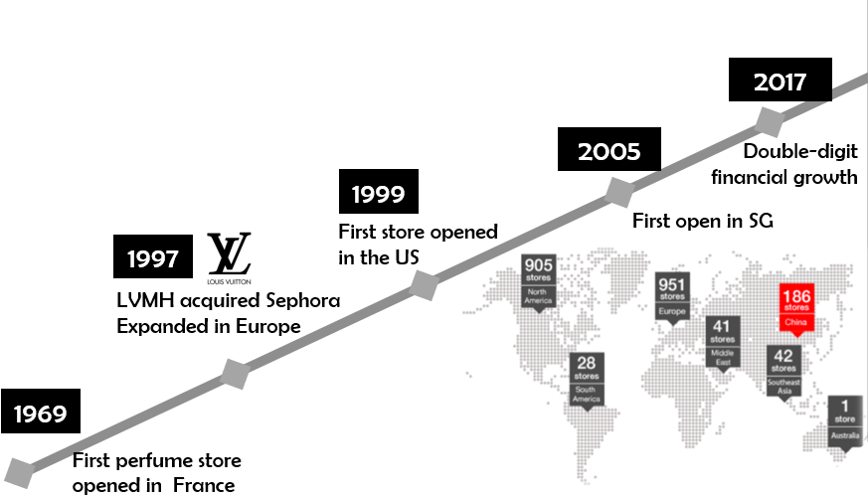
A wonderful Global Presence!

Slide 5
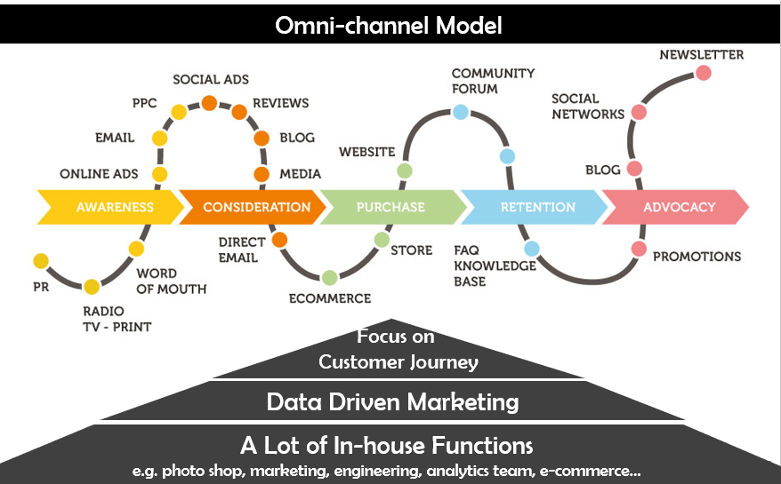
Sephora has been successful because of

Slide 6
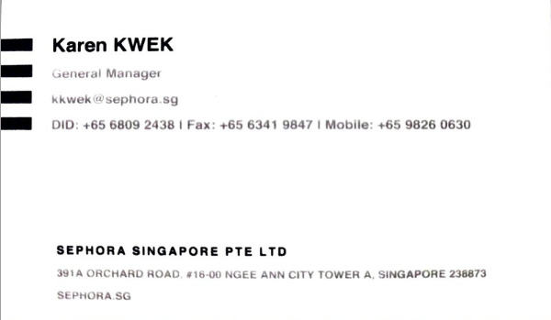
Research Methods
Store Visits
Customer Interviews
Discussion with Executives
Found Insights and Identified Issues

Slide 7
Purpose & Values
Purpose: Inspiring Fearlessness
“ At Sephora, we believe beauty is for each person to define and ours to celebrate. Together, we support and encourage bold choices in beauty—and in life. Our purpose is to inspire fearlessness. ”
Values
“ At Sephora we live, breathe and act by our values: Passion, Innovation, Expertise, Balance, Respect for All, Teamwork, and Initiative.”
https://jobs.sephora.com/content/our-story/

Slide 8
Business Analysis

Slide 9
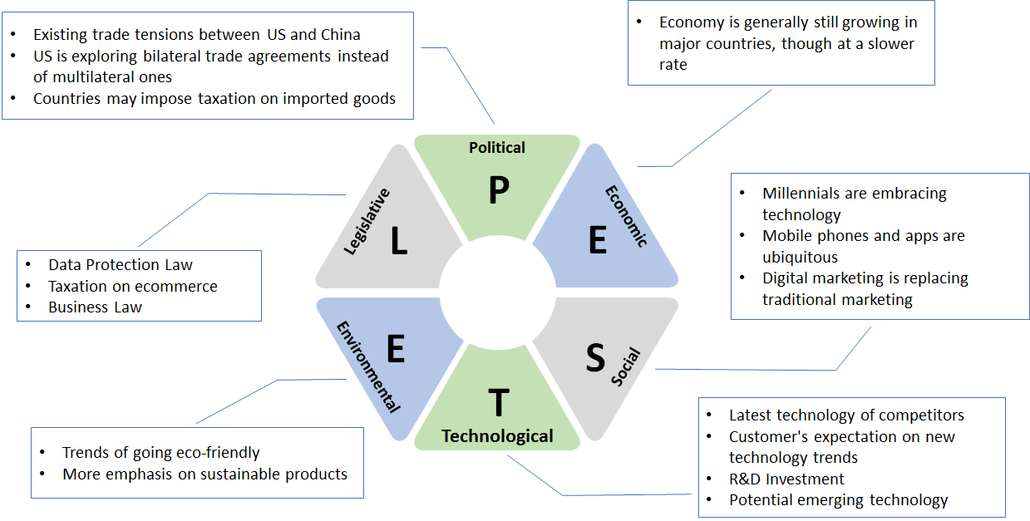

PESTEL Analysis (Sephora)

Slide 10
Scope & Problems
In-store customer experience
Digital Experience
Store/Inventory Management
Many Potential trending technologies to further enhance in-store experiences
Many Potential trending technologies to further enhance digital experiences
Staff restock manually by hand
Can be hard and make in-store traffic jammed when store is crowded

Slide 11
Customer Journey
Awareness
Explore
Try-on
Purchase
Post-buy
- Social Media
- Ads
Online
- Web Review
- Beauty Board
- Chatbot & In-App Voice Control
Offline (In-store)
- Beacon Tech
- Color IQ
- Fragrance IQ
- In-store try on
- In-store 3D AR Mirror
- Tryout samples taken from store
- Virtual try on with AR on mobile
- Store purchase
- Online purchase
- Subscription (Only in US)
- Write Review
- Re-purchase
- Loyalty & Rewards
Notes:
Online
Read Review on Web
Beauty Board
Chatbot & In-App Voice Control
Messenger (FB)
Kik (Teen-focused messing app) - with Kik Points rewards - watching ads
Offline
Mobile app giving info
Beacon Technology for location-based
In-shop device giving info
Color IQ (Scan and recommend color)
Fragrance IQ (Recommend fragrance)
Beauty Staff at store

Slide 12
Key Processes
Explore
Try-on
Purchase

Slide 13
Current Process (As-Is)

Slide 14
As – Is Process : Offline
No
Staff Availability
Irritated Staff
Found?
Try Products (Beauty Studio)
Like?
Go to Counter checkout
Enter Store
Search for product
Pay
Customer
Yes
Staff Availability for Beauty Studio
Not sure about product matching skin requirement
Long Queues at peak hours
Staff availability at counters
Product Availability
Not able to find Product
Time to find product
Price not very clear
Not enough Information
Time Taking Process
Pack And hand over
Sephora
Assistance

Slide 15
As – Is Process : Online
No
Found?
Selects product
Select delivery address
Select payment mode
Confirm purchase
Opens App
Search for product
Customer
Yes
Deliver Product
Wrong product delivery
Lost Package
Long shipping duration
Did not like product
Product Out Of Stock
Not sure if product color will match skin tone
Not many male products
Process Order
Sephora

Slide 16
Recurring Order Process

Slide 17
Delighting Customers – Recurring Online Orders
Swimlanes (As-Is)
Opens App
Search for product
Selects product
Choose quantity
Go to checkout
Select delivery address
Customer
Confirm purchase
Select payment mode
Process purchase
Sephora

Slide 18
Delighting Customers – Recurring Online Orders
X
X
X
Swimlanes (As-Is)
X
X
Opens App
Search for product
Selects product
Selects quantity
Go to checkout
Select delivery address
X
Customer
Confirm purchase
Select payment mode
Customer doing most of the work
Process purchase
Sephora

Slide 19
Delighting Customers – Recurring Online Orders
Customer enjoys seamless experience
Swimlanes (To-Be)
Opens App via reminder
Reviews product and quantity
Confirm purchase
Customer
Performs analytics
Identifies customer and product
Package promotion with reminder
Push reminder
Process purchase
Sephora
Sephora does the work

Slide 20
Supplier Process - Increasing predictability of demand
Recurring Online Orders
Gets notified by Sephora
Manufactures right quantity of products
Supplier
Performs analytics
Identifies customer and product
Predicts product and quantity required
Updates store inventory
Sufficient stock for customers
Sephora

Slide 21

Proposed Technology Innovation

Slide 22
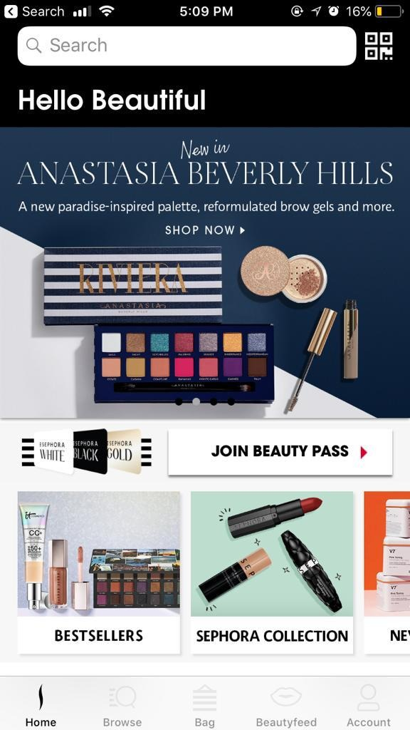
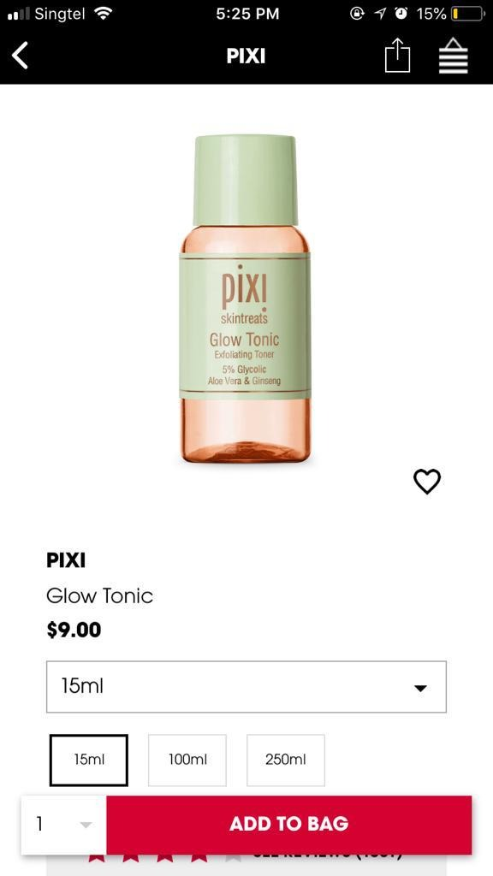
Custom Blend App
Trial product delivery feature
Currently It suggests only one brand or one shade of foundation or concealer
Use facial recognition and AI solution to mix different shades of foundation to specifically match customer skin tone
I want to Try
Notes:
Currently it suggest only 1 foundation type
In Reality, It sometime needs mixture of say 2 brands
App could incorporate it and tell the idea
Use facial recognition and AI solution to mix different shades of foundation to specifically match customer skin tone
Customer Browse through product
Click “I want to try”
Sephora delivers at home

Slide 23
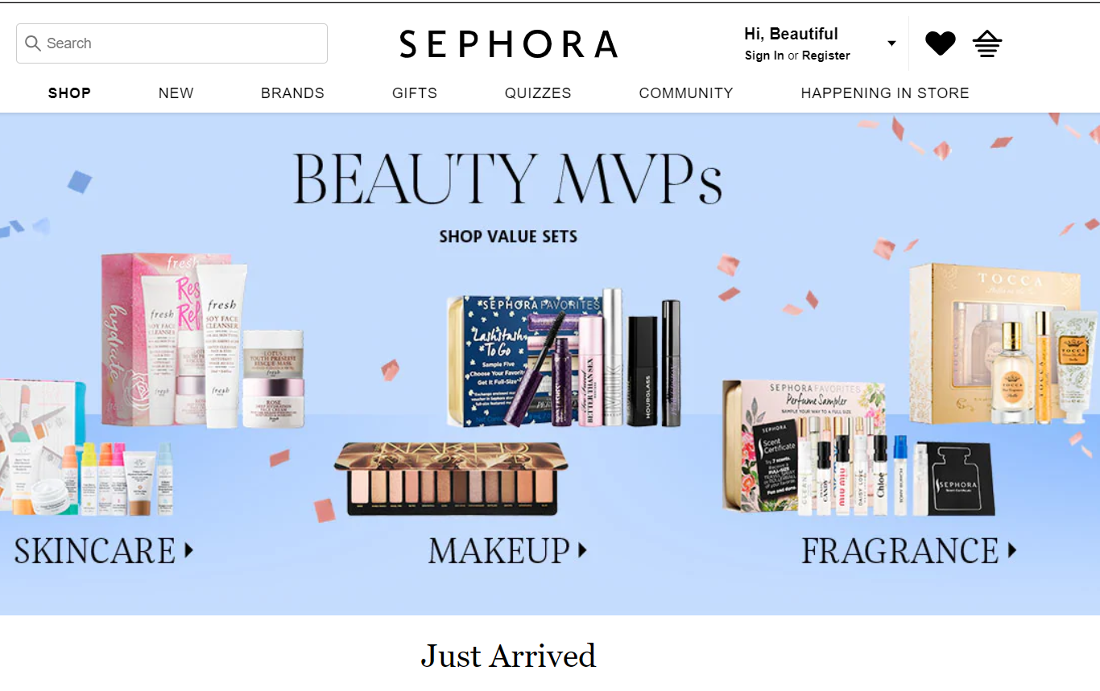

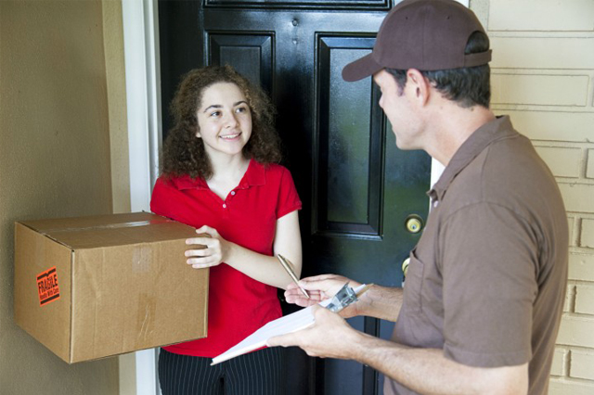
Recommendation Based trials
Customer Buys online/Offline
Sephora implements recommendation engine
It delivers trials at customer site for upsell/cross-sell

Slide 24
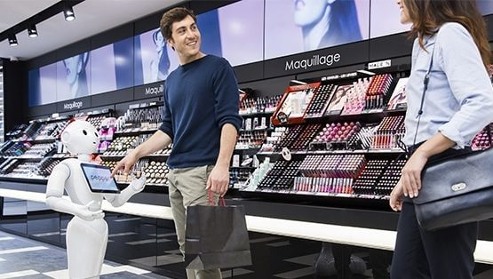
Smart Replenishment
Restocking shelves, finding and returning misplaced products and tracking inventory levels are the most time consuming tasks
Recommend Sephora to Use Robots to facilitate the process.
Notes:
A roving robot to traverse the store collecting information, making sure pricing is up to date and shelf tags are accurate, identify out of stocks and keep track of overstock items that are kept on the top shelf to reduce backroom trips for inventory replenishment
Feed in the layout of the store
Picks and identifies through code scan
Put it in the right bucket

Slide 25

Powerful Proximity Marketing campaign
Make use of iBeacons and Android Beacons for in-store marketing experience

Slide 26

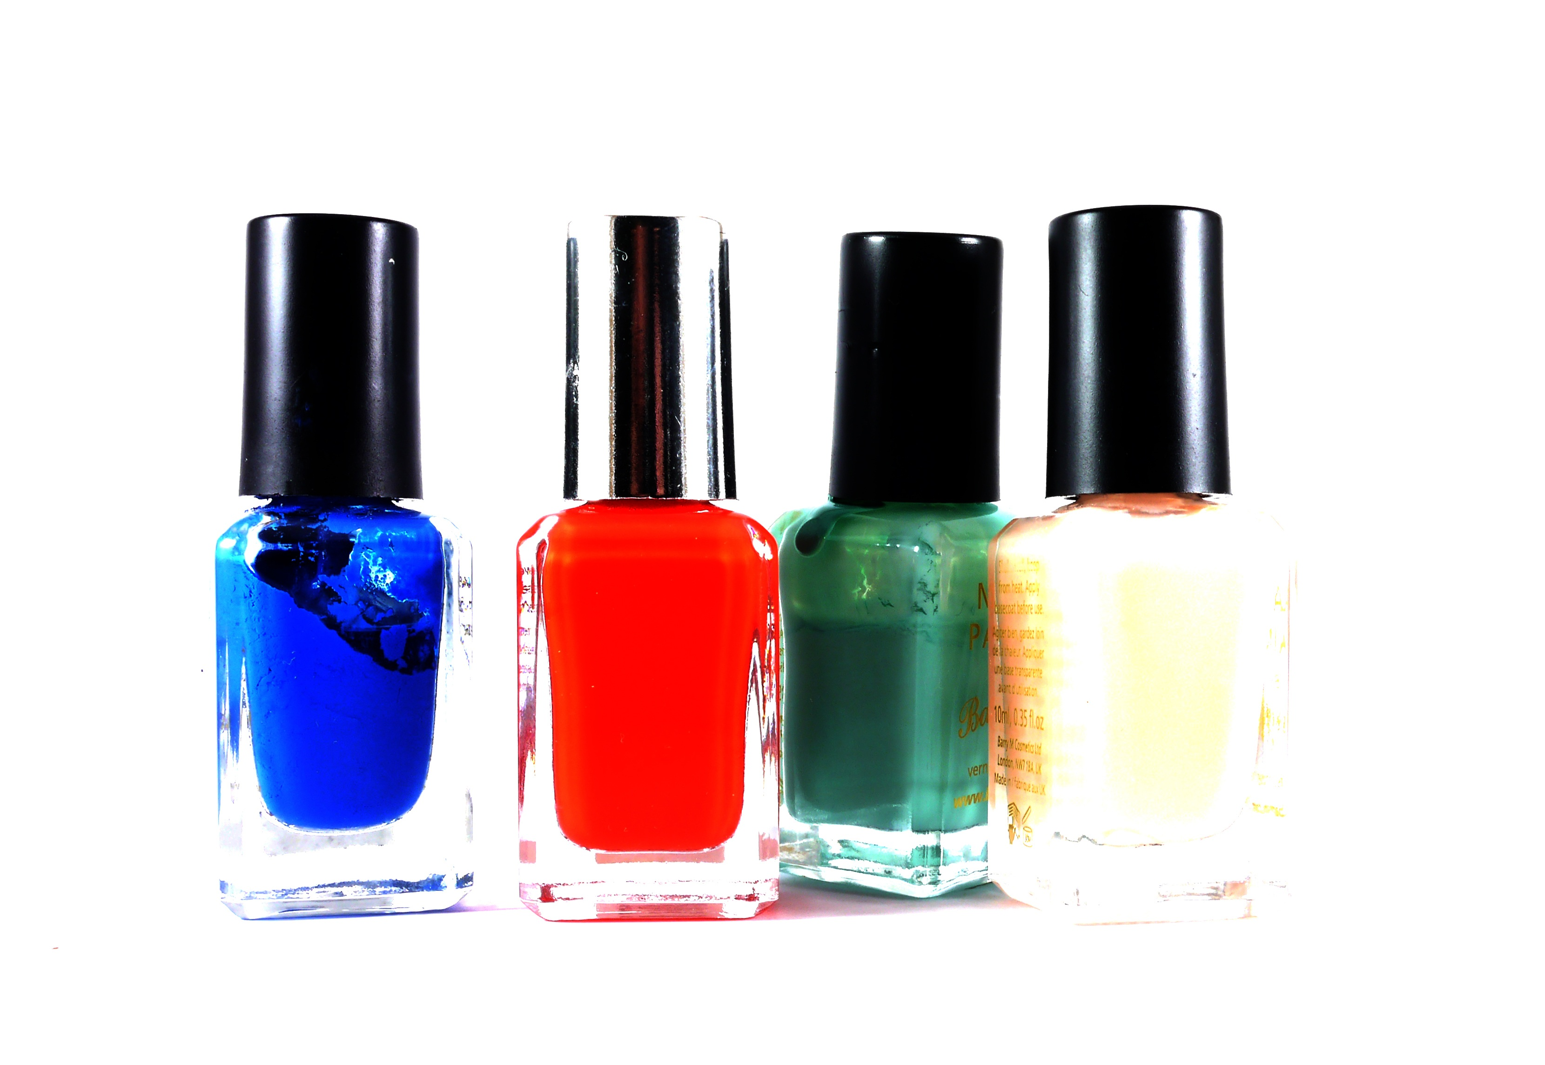
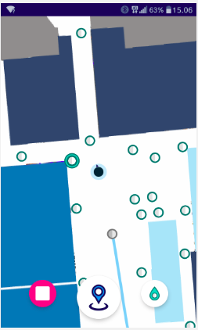
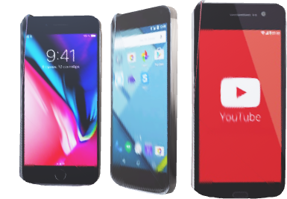

Smart Finder (APP)
Customer Enter the Store
Open App/ In-Store Map
Search for the item for in store lookout
Indoor Layout suggests the path

Slide 27
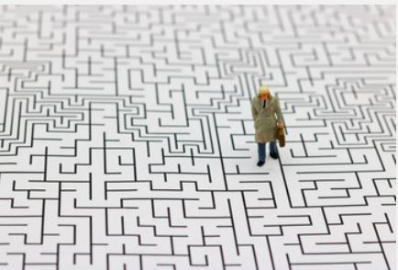
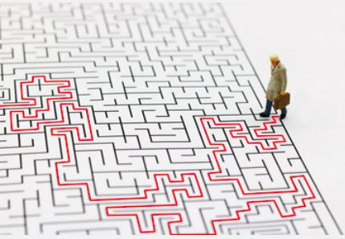
No More Solving The Maze

Slide 28
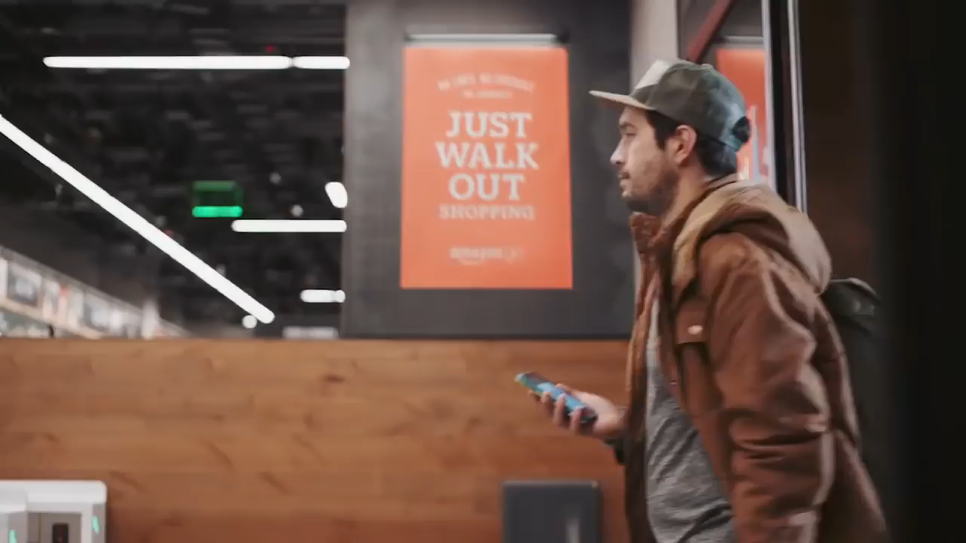

Smart Checkout

Slide 29


Smart Beauty Studio
Notes:
DIY type of experience
Take before, Mirror replaces with smart mirror
Try apply make-up
Automated feedback with user personalization

Slide 30

Smart Peer Collaboration

Slide 31

Smart Peer Collaboration
Found Product?
Enquire Product
Yes
Buy And Exit
No
Order at neighbor Partner Store
Reduced Waiting Time

Slide 32



Summary
Business Analysis
Tech Innovation
Business Introduction
Process Improvement
Customer
Staff
Personal

Slide 33
Thank You! Questions?

